Slide 1
Trade Fairs in Marketing Mix Germany 2015-16
From AUMA research

Slide 2
Marketing instruments: usage and importance
Instrument | Usage |  | Importance
Year | 2010 | 2015 | 2010 | 2015
Own Website | 97% | 99% | 89% | 90%
Trade Fairs | 100% | 100% | 84% | 84%
Personal sales / sales agents | 81% | 77% | 79% | 76%
Direct Mailing: Print, E-mails, Leaflets | 87% | 82% | 54% | 51%
Trade Press Advertising | 70% | 74% | 40% | 40%
Events incl. Owns shows, Road-shows | 51% | 48% | 41% | 39%

Slide 3
Marketing instruments: usage and importance 2.
Instrument…… | Usage |  | Importance
Year | 2010 | 2015 | 2010 | 2015
Internet Sales | 54% | 48% | 40% | 33%
PR | 56% | 52% | 39% | 32%
Congress Presentations | 45% | 43% | 31% | 31%
Social Media | 17% | 41% | 11% | 22%
On-line Advertising | 35% | 42% | 15% | 19%
Outdoor Advertising | 33% | 30% | 17% | 14%

Slide 4
Marketing instruments: usage and importance 3.
Instrument…… | Usage |  | Importance
Year | 2010 | 2015 | 2010 | 2015
Newspapers Advertising | 39% | 36% | 18% | 14%
Business Papers Advertising | 30% | 26% | 15% | 13%
Telephone Marketing, Call Centers | 14% | 15% | 12% | 10%
Sponsoring | 34% | 39% | 10% | 10%
TV- Radio - Advertising | 7% | 6% | 7% | 4%

Slide 5
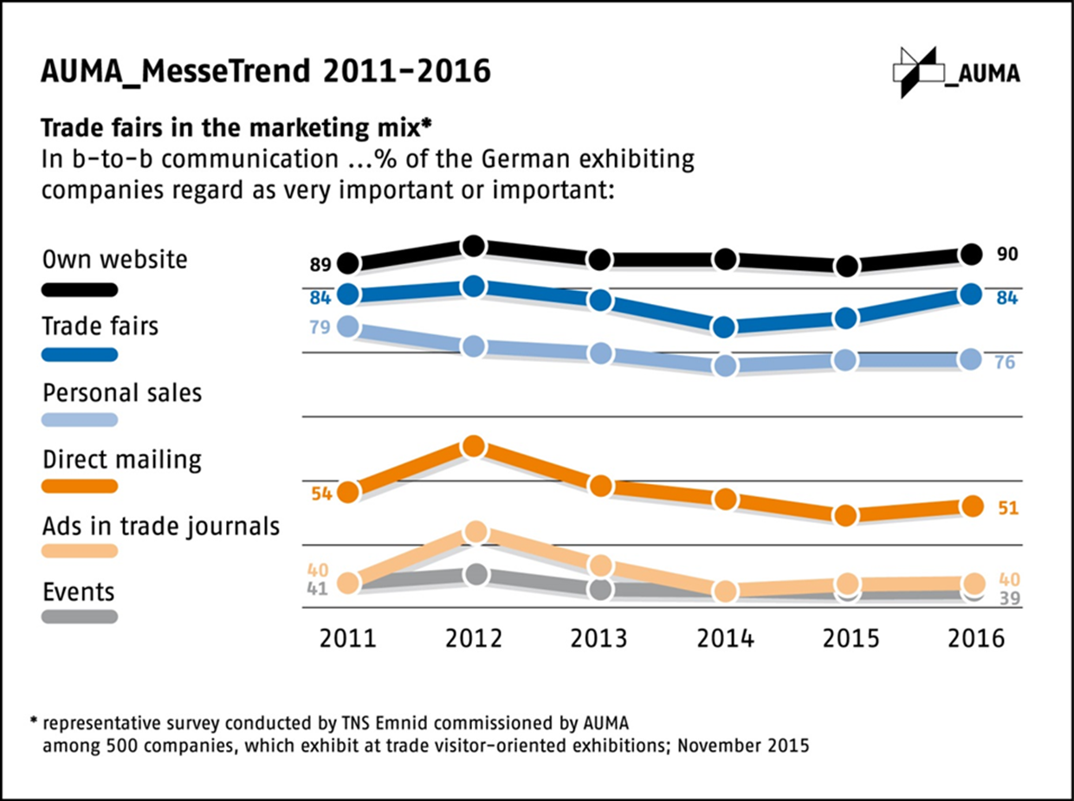

Slide 6
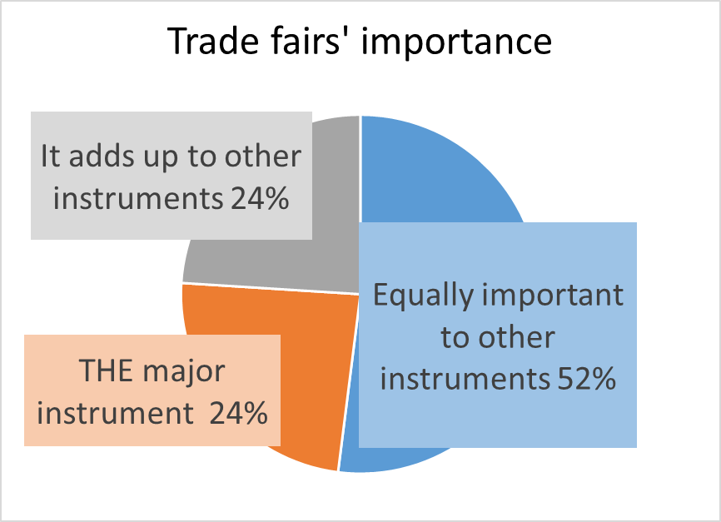

Slide 7
